Slide 1
Traffic Stops and Racial Bias
Using pattern recognition to demonstrate disparity

Slide 2
Activity 1: Small group random sampling
You are going to use random sampling to understand the color makeup of simple objects in a bag, which represent a population. You will create a sample by drawing fifty objects from the bag, recording the color of the object you draw each time using tally marks in the table in your packet.
Driving question: What is the color makeup of the population represented by all objects in this bag?

Slide 3

Activity 1: Small group random sampling
Yellow |  | Total:
Green |  | Total:
Red |  | Total:
Blue |  | Total:

Slide 4
Activity 1: Small group random sampling
Now that you have created your sample, you can estimate the color makeup of the population represented by the objects in the bag. Divide each color’s total by 50 (the number of objects you drew to create your sample) to estimate the percent makeup of each color within the population. For example, if you drew 13 green objects, your percent green would be 13 ÷ 50 = 26%.
___________________ ___________________ ___________________ ___________________
percent yellow percent green percent red percent blue
26%

Slide 5
Activity 2: Combining small group samples
Given your relatively small sample size, you know that there is probably a significant amount of sampling variability within your estimated color makeup for this population. One way to decrease sampling variability is to increase sample size. To do this efficiently, you will combine your small group random sampling data with the other groups in your class. The objects in their bags are identical to yours. As a class, complete the table in your packet by filling in the total (out of 50) of each color by each group.
Driving question: What is the color makeup of the population represented by all objects in all bags?

Slide 6
Activity 2: Combining small group samples
 | Group 1 | Group 2 | Group 3 | Group 4 | Group 5 | Total
Blue | 26 | 18 | 23 |  |  | 67
Green | 12 | 15 | 11 |  |  | 38
Red | 6 | 13 | 8 |  |  | 27
Purple | 6 | 4 | 8 |  |  | 18

Slide 7
Activity 2: Combining small group samples
With these new totals, you can more accurately estimate the color makeup of the population represented by the objects in all of the bags. Divide each color’s new total by (50 ✕ # of groups) to estimate the percent makeup of each color within the population. For example, if there are four groups and the total number of red objects was 44, your percent red would be 44 ÷ (50 ✕ 4) = 22%.
___________________ ___________________ ___________________ ___________________
percent yellow percent green percent red percent blue
22%

Slide 8
Activity 2: Combining small group samples
How do these new numbers compare to your small group’s numbers?
Do you believe that they are more accurate in representing the true color makeup of the population represented by all objects in these bags?

Slide 9
Activity 3: Comparison to real-world data
The objects and bags you have been working with represent the racial makeup of the United States driving population. The following table shows real data collected by the US Government in 2011, representing the “real” makeup of this population.
Race | Driving population | Color in bags
White | 153,358,921 | Yellow
Black / African American | 21,322,976 | Green
Hispanic / Latino | 25,495,436 | Red
Other | 12,121,516 | Blue

Slide 10
Activity 3: Comparison to real-world data
Using the total count of this population, 212,298,850, calculate the new percentages for each race within the total driving population of the United States.
___________________ ___________________ ___________________ ___________________
percent White percent Black / percent Hispanic / percent Other
African American Latino
72%

Slide 11
Activity 3: Comparison to real-world data
How do the real numbers compare to your whole class numbers?
Why might there still be a difference?

Slide 12
Activity 4: An introduction to traffic stops
Discussion question: What do you already know about traffic stops?

Slide 13
Activity 4: An introduction to traffic stops
We will now watch two short videos on traffic stops in the United States.
These videos contain serious content about a sensitive subject. You are expected to embody our core values of Community and Compassion as we watch and discuss these topics with respect and maturity.
Anyone unable to meet this expectation will be asked to leave this classroom immediately.

Slide 14
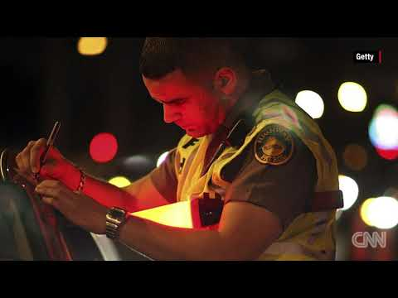

Slide 15
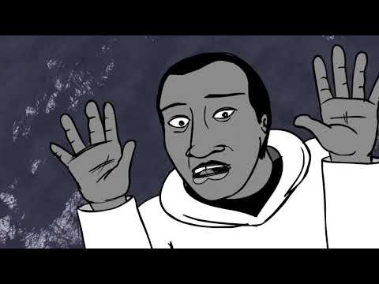

Slide 16
Activity 4: An introduction to traffic stops
Do you think police officers should be able to search a suspect’s car without first securing a warrant?

Slide 17
Activity 5: Analyzing traffic stop data by race
From Activity 3, you now know that 72% of the United States driving population identifies as White, while 10% identify as Black / African American, 12% identify as Hispanic / Latino and 6% identify as another race or combination of races.
If you were to take a large, random sample of drivers that had been subject to a traffic stop in a given year, what percent of those drivers would identify as White if police stopped drivers of all races at equal rates? What percent of those drivers would identify as Black / African American?
Do you expect that police stop drivers of all races at equal rates?

Slide 18
Activity 5: Analyzing traffic stop data by race
We will use a tree diagram to visualize the probabilities of drivers identifying as different races being subject to a traffic stop. This tree diagram is simple for now, but we will add to it in Activity 6. The probability data (provided by the United States Department of Justice, based on data collected during 2011) for a driver of each race being stopped within a calendar year is provided in a table.

Slide 19
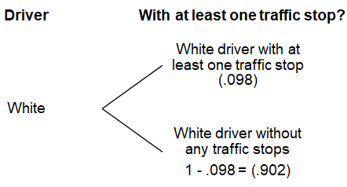
Complete the tree diagram in your packet using the probabilities listed in the table. You can round each result to three decimal places, but be careful with your decimal places and zeroes!
Race | % of drivers with at least one traffic stop
White | 9.8%
Black / African American | 12.8%
Hispanic / Latino | 10.4%
Other | 10.5%

Slide 20
Activity 5: Analyzing traffic stop data by race
Explain what the numbers in that tree diagram mean.
Are drivers of races equally likely to be subject to a traffic stop in a given year?
If not, would you characterize the differences as significant?

Slide 21
Activity 6: Analyzing traffic search data by race
We are going to expand our tree diagram with search data in addition to our traffic stop data. Follow these steps to complete the new tree diagram:
Begin by copying your probabilities from the previous tree diagram.
Use the table to add the probabilities of a stopped driver being searched.

Slide 22
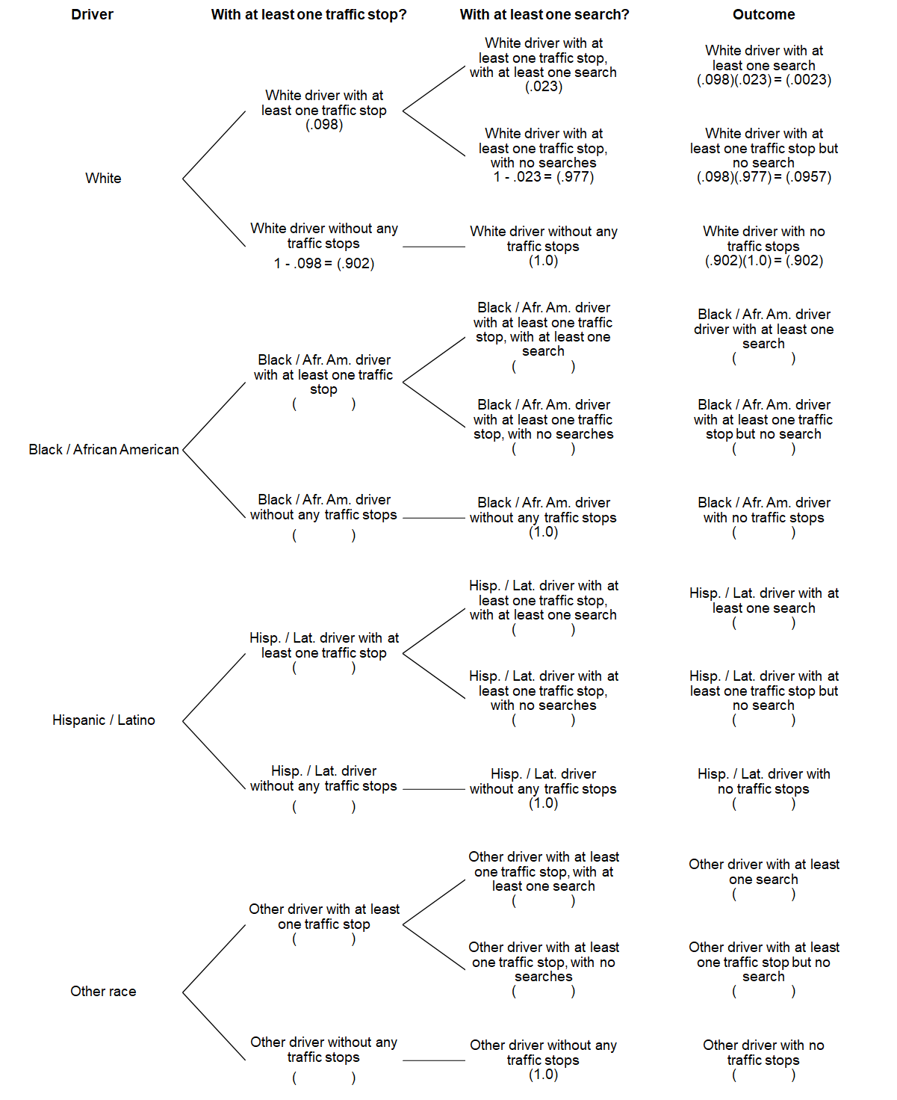
Race | % of stopped drivers with at least one search
White | 2.3%
Black / African American | 6.3%
Hispanic / Latino | 6.6%
Other | 4.4%

Slide 23
Calculate the outcome of each row by multiplying the probability of a driver being stopped with the probability of a stopped driver being searched to find the probability that a driver will be searched at least once during the year. You can round each result to three decimal places, but be careful with your decimal places and zeroes!

Slide 24
Activity 6: Analyzing traffic search data by race
Fill in the table after the tree diagram with the probability of a driver of each race experiencing at least one traffic search within a given year.
Race | % of drivers with at least one search
White | 0.23%
Black / African American
Hispanic / Latino
Other

Slide 25
Activity 6: Analyzing traffic search data by race
Explain what the numbers in that table mean.
Are drivers of races equally likely to be subject to a search at a traffic stop in a given year?
If not, would you characterize the differences as significant?
Race | % of drivers with at least one search
White | 0.23%
Black / African American | 0.81%
Hispanic / Latino | 0.68%
Other | 0.46%

Slide 26
Activity 7: Comparing percentages
If we multiply the % of drivers of each race with at least one search by the driving population of that race, we can calculate the total number of drivers of that race that can expect to be subject to a search in a given year.
Race | % of drivers with at least one search | Driving population | # of drivers that can expect to be searched
White | 0.23% | 153,358,921 | 352,725
Black / African American | 0.81% | 21,322,976 | 172,716
Hispanic / Latino | 0.68% | 25,495,436 | 173,368
Other | 0.46% | 12,121,516 | 55,759

Slide 27
Activity 7: Comparing percentages
By dividing those numbers of searched drivers (by race) by the total number of searched drivers (754,568), we can calculate the percent of all searched drivers that identify with that race.
Do the percentages of all searched drivers identifying with each race match your random sampling results from Activity 1? Do you think traffic searches are random?
Race | # of drivers that can expect to be searched | % of all searched drivers | % of all drivers
White | 352,725 | 47% | 72%
Black / African American | 172,716 | 23% | 10%
Hispanic / Latino | 173,368 | 23% | 12%
Other | 55,759 | 7% | 6%

Slide 28
Activity 8: Exploring King County Data
For this final activity, you will perform random sampling on real King County traffic search data from January 2009 to March 2016. There were 28,105 traffic searches conducted in King County during this timeframe.
You will pick random numbers between 2 and 28,105, look at that row in the King County Traffic Search spreadsheet, and record that search based on the reported race of the driver.
When time is up, calculate the percentage of traffic stops by race by dividing your tallies for each race by the total number of stops you recorded.
Data spreadsheet: tinyurl.com/kingtraffic

Slide 29
Activity 8: Exploring King County Data
White |  | Total:
Black |  | Total:
Hispanic |  | Total:
Asian |  | Total:
Other |  | Total:

Slide 30
Activity 8: Exploring King County Data
Here are the results you’d get if you counted every row from that spreadsheet. Note that population data below comes from the 2010 census.
How do the results from King County compare with national results?
Race | % of all searched drivers | % of all people
White | 57% | 68%
Black / African American | 17% | 6%
Hispanic / Latino | 13% | 9%
Asian | 11% | 16%
Other | 2% | 1%

